Slide 1
HOMEWORK 1- Baltimore 911.csv
Submitted by
Jaswanth Ram Nagabhyrava
NW46934

Slide 2
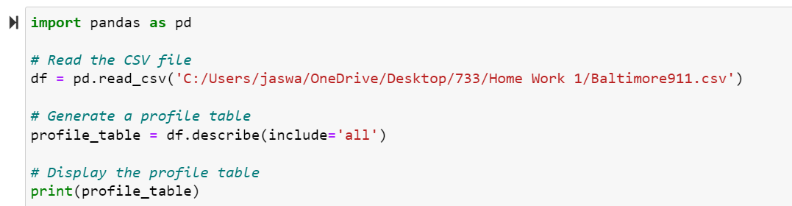
Task 1
Creation of profile table to get an overview of the dataset.
Here is the snippet of the code

Slide 3
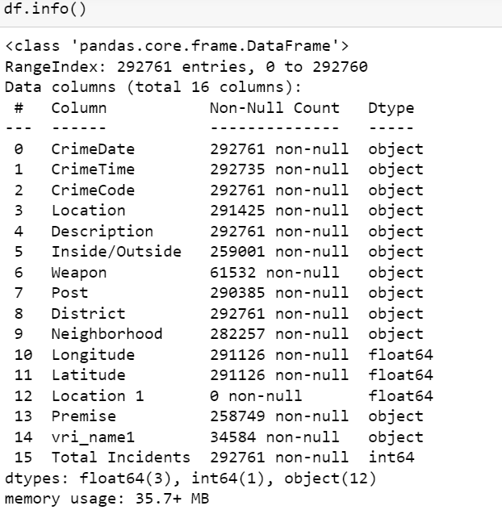
Here is the snippet information of the profile which attribute is which data type

Slide 4
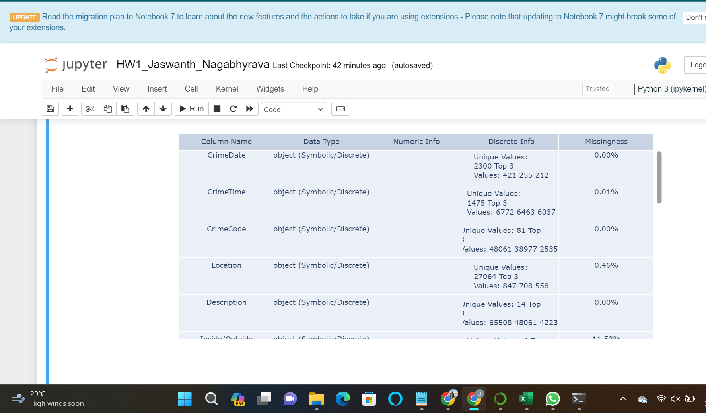
Here is the snippet of the output for the task 1 after cleaning the dataset

Slide 5
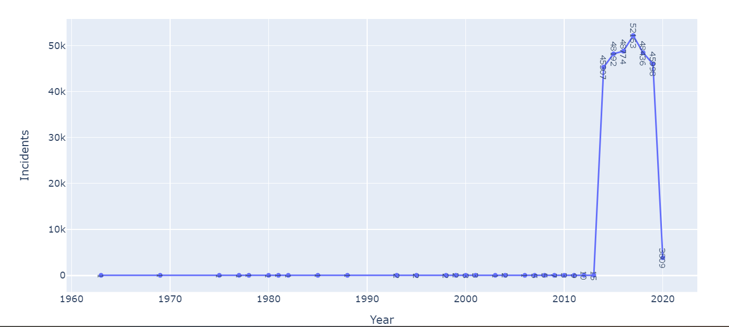
TASK 2 : For Gary to understand the data have generated a series of temporal plots where he can get an overview of the overall crime happened in Baltimore
For Gary’s reference we have added included the snippets of the series of plots where he can get the overview of the data
Year graph

Slide 6
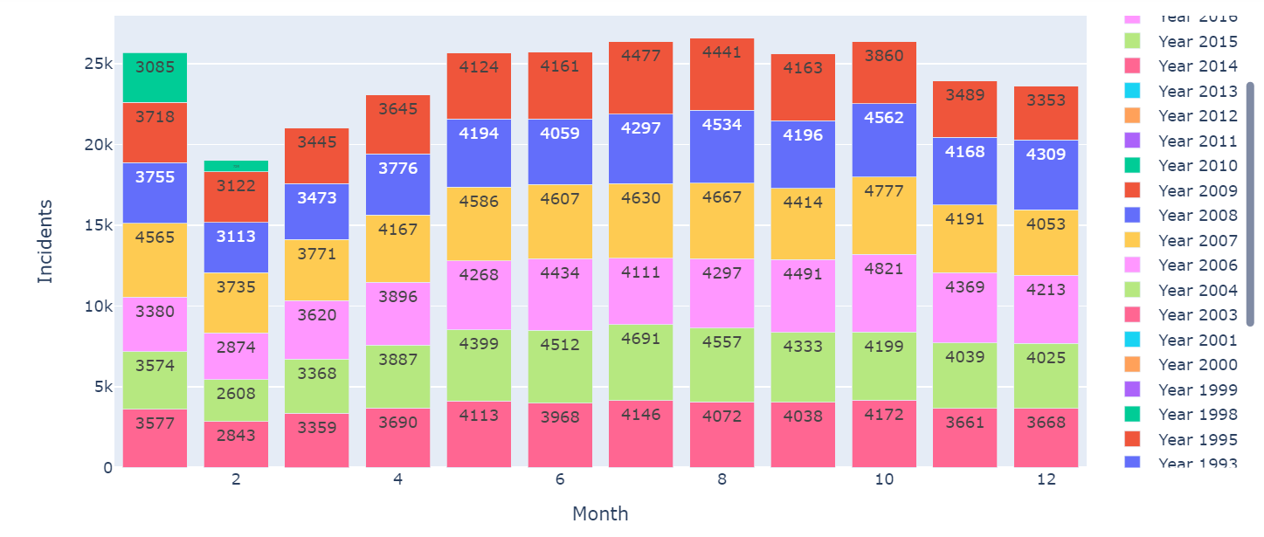
More Snippets of the Task 2

Slide 7
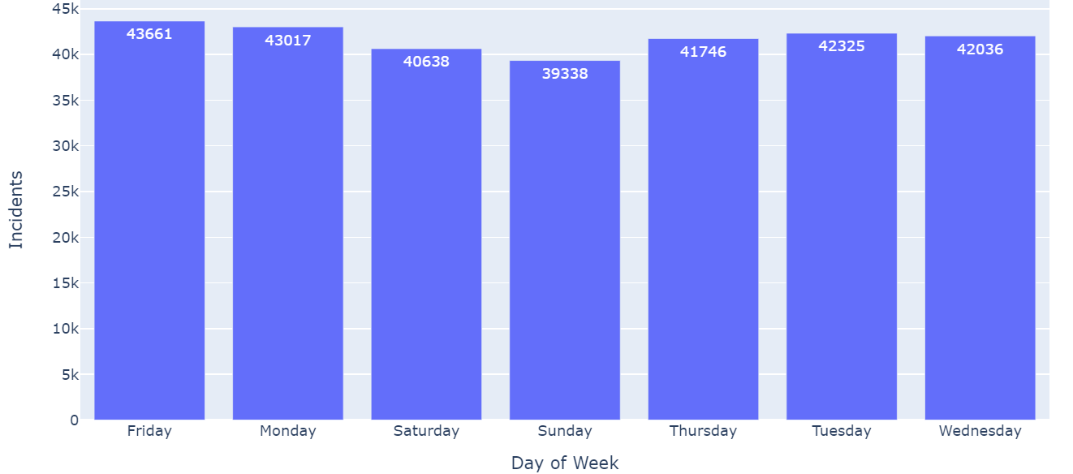
By using the above snippets Gary can able to know the no of incidents happened in the baltimore where he can also able to get a clear overview on the no of of incidents

Slide 8
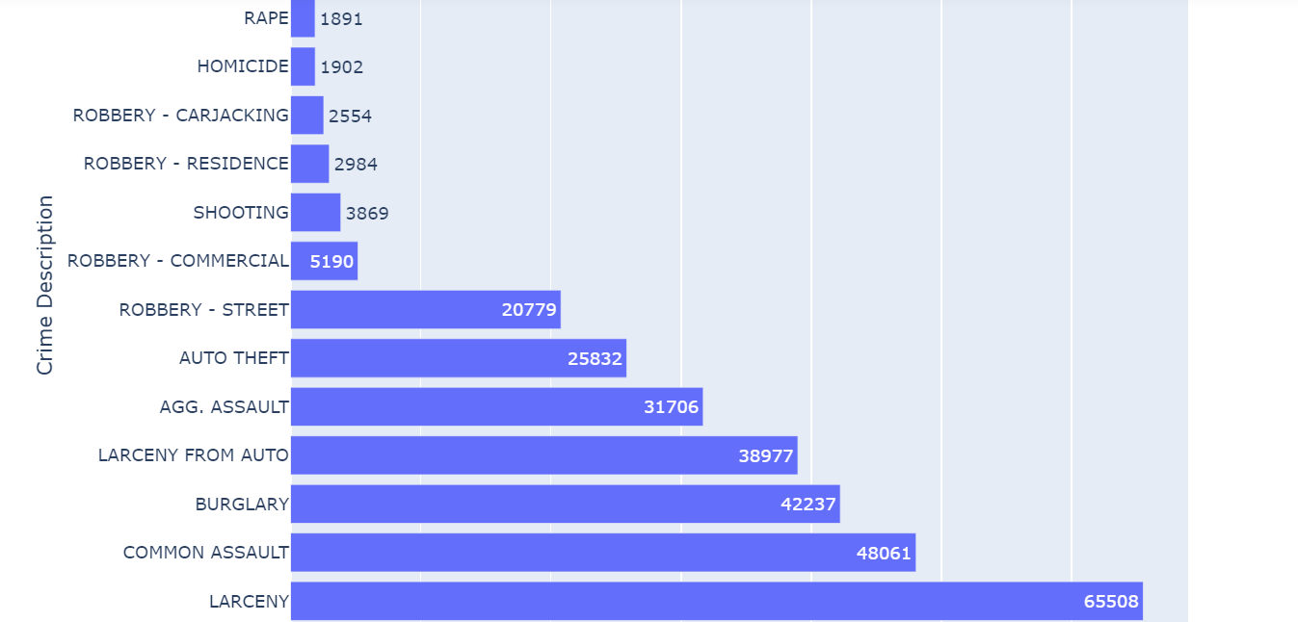
Task 3 In this task we have show to gary the geospatial data based on the crime type
In this snippet Gary can able to know the crime type frequency to know the no of incidents happened.

Slide 9
Task 4 In this task for Gary we have to create a series of plots where he can crime type distribution based on the year to year, monthly to monthly and day to day.
For the task officer can able to understand the year to year month to month and day to day types of crimes that are being happend in the city.
This types of series plots can help the officer in the solving the crime very easily and able to gather information very quickly
In the next slide i have added the output of the snippets.

Slide 10
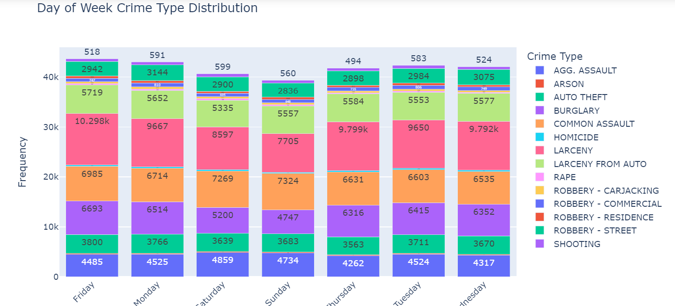
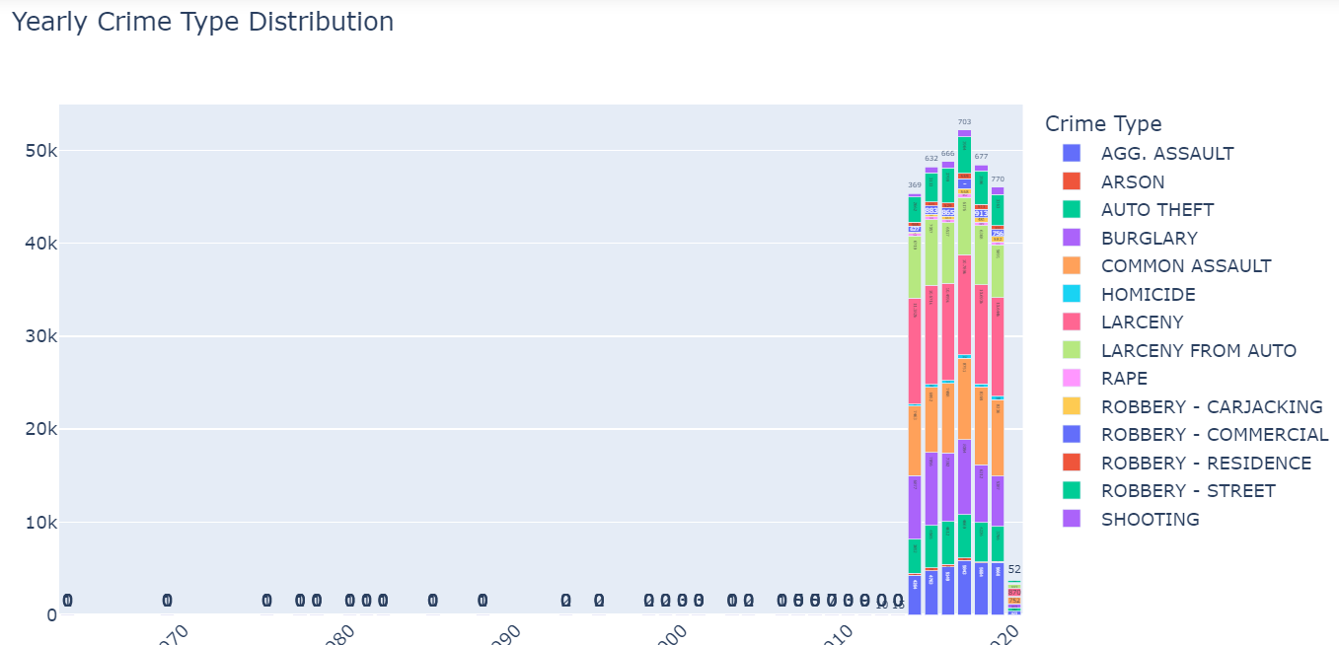
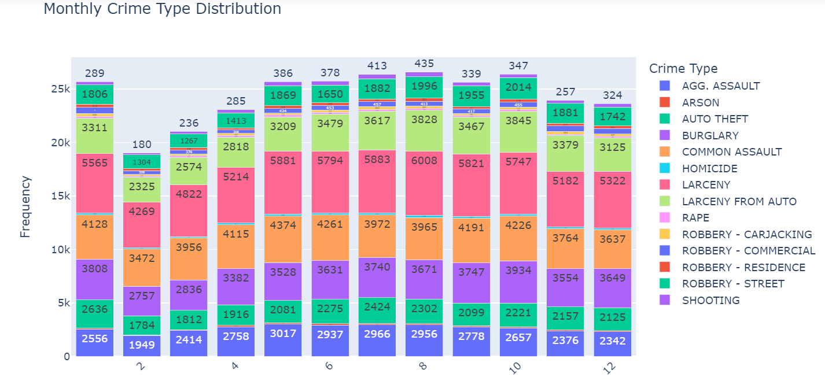

Slide 11
Task 5
For officer we have to create a Crime Exploration Dashboard where officer can able to enter the location name, start year, end year, time
So for the officer to understand it easily i have added the snippets

Slide 12
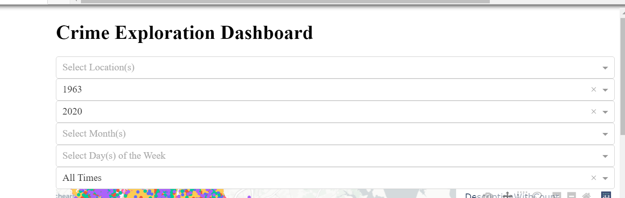

Slide 13
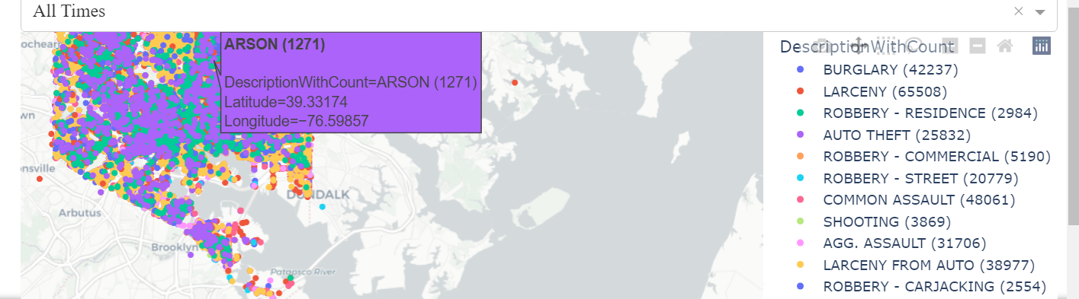
Snippet of the geospatial distribution of the data so that the viewer can able to view the data by using input fields

Slide 14
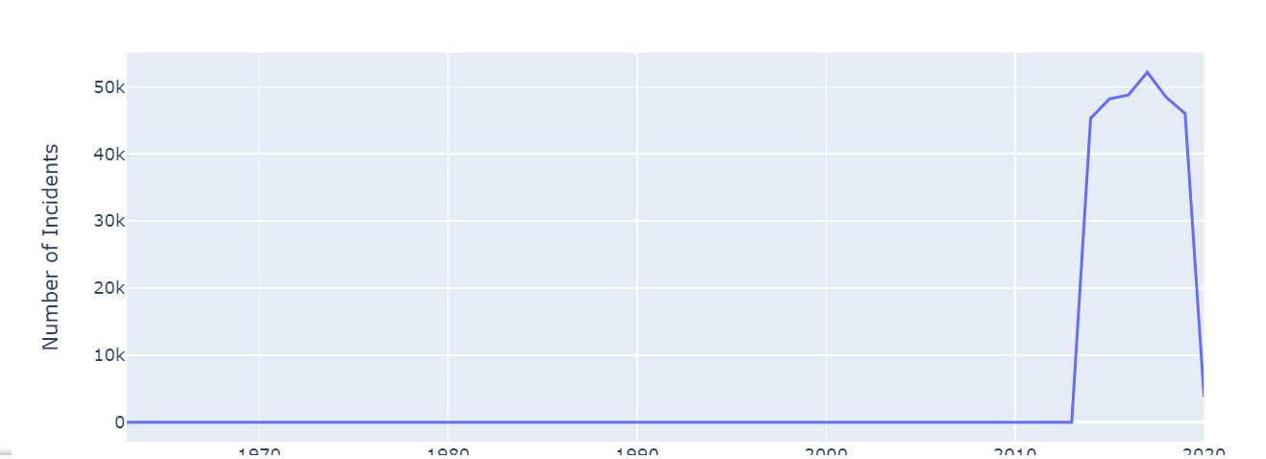
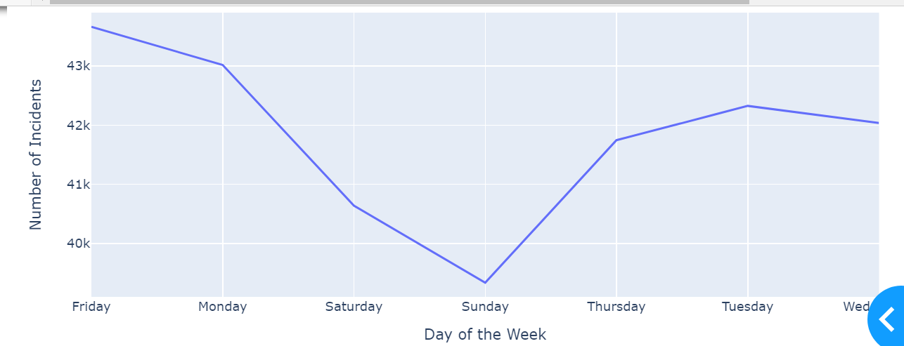
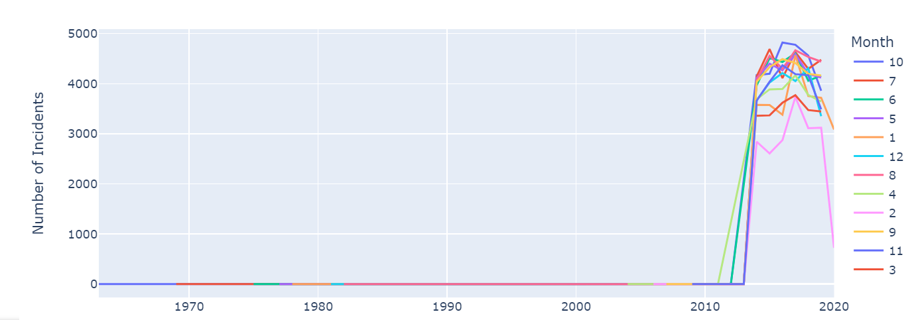
Here are the more snippets for the temporal distribution of database on year, month and day of the week

Slide 15
GPT Conversation Link:
https://chat.openai.com/share/88e2b541-ab34-4452-a63a-b25380d4381f

